Slide 1
Session 2

Slide 2
Data preprocessing is important

Slide 3
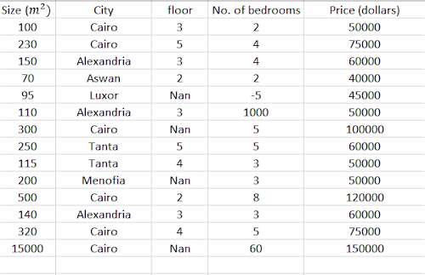
Can you identify some problems?

Slide 4


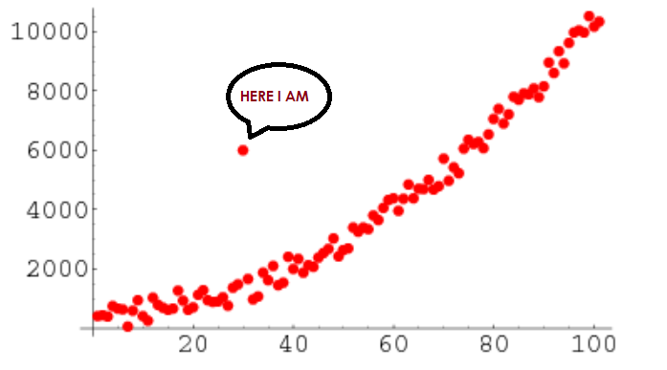
Common problems
Categorical data
Missing data
Outliers
Feature Scaling

Slide 5

01
Categorical data

Slide 6
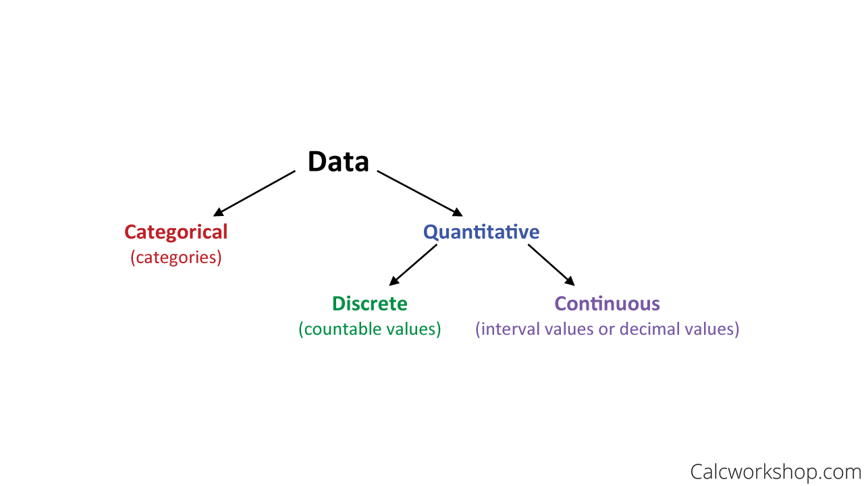
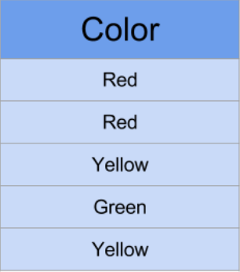
Categorical data

Slide 7
Categorical data
Can we feed categorical data into a machine learning model?
Handling categorical data:
Label encoding
One hot encoding
NO

Slide 8
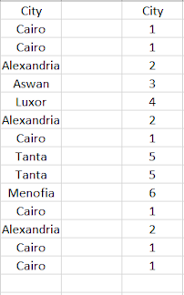
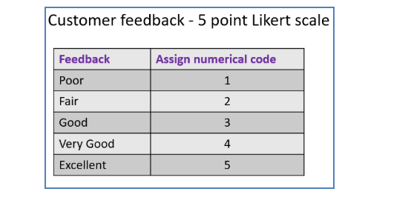
Giving each category a value to represent it
Label encoding

Slide 9
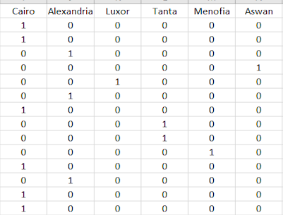
Giving each category a Boolean column to represent whether it is true or false
One hot encoding

Slide 10
02
Missing data

Slide 11
We have many options some of them are: - Drop the column with the missing data - Choose the median, mean or any value to replace the missing data - Drop rows with missing data
Missing data

Slide 12
03
Feature scaling

Slide 13
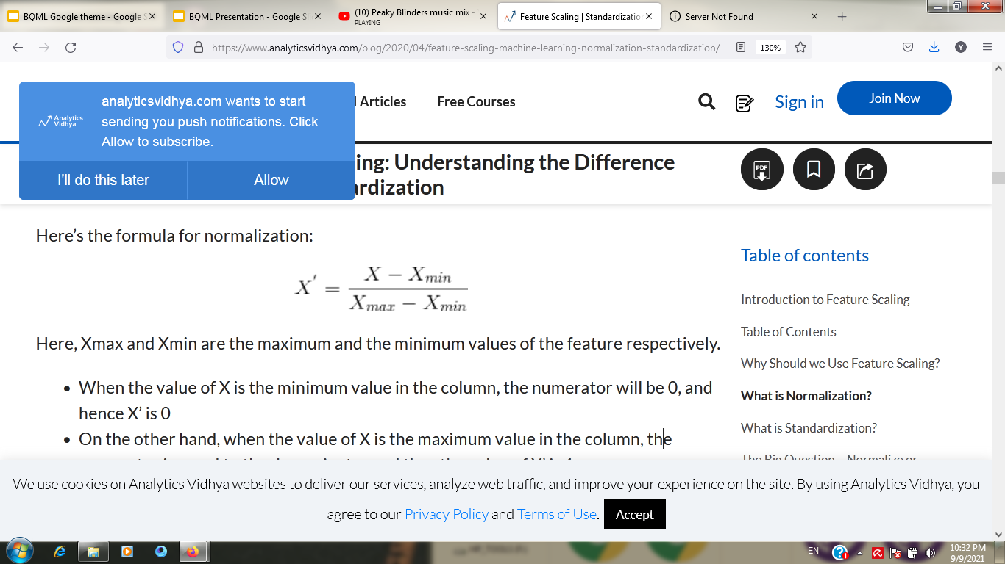
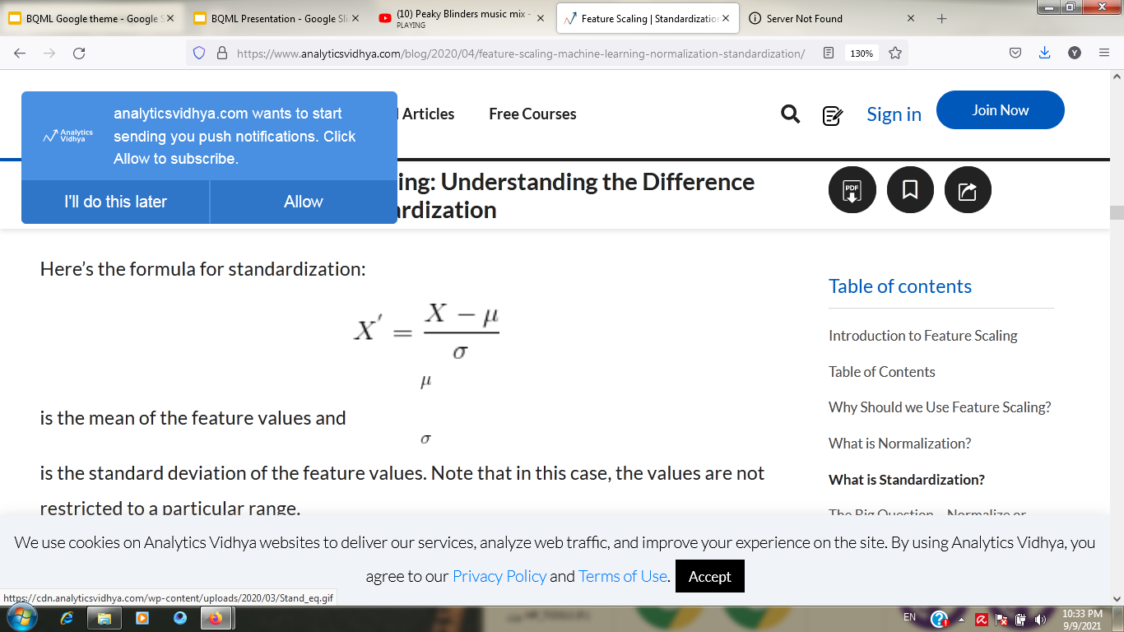
Two main ways to scale our features: Two ways to achieve it: - Min-Max scaling(normalization) - fixed range - simple - Standardization - No fixed range - Much less affected with outliers
Feature scaling

Slide 14
04
Outliers

Slide 15
Outliers

Slide 16
Preprocessing Notebook:

Slide 17


CNNs

Slide 18
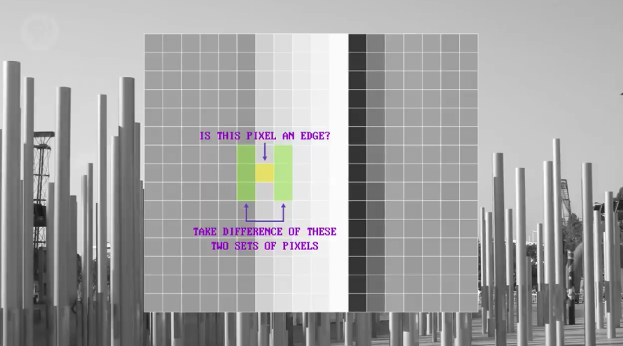
Filters

Slide 19
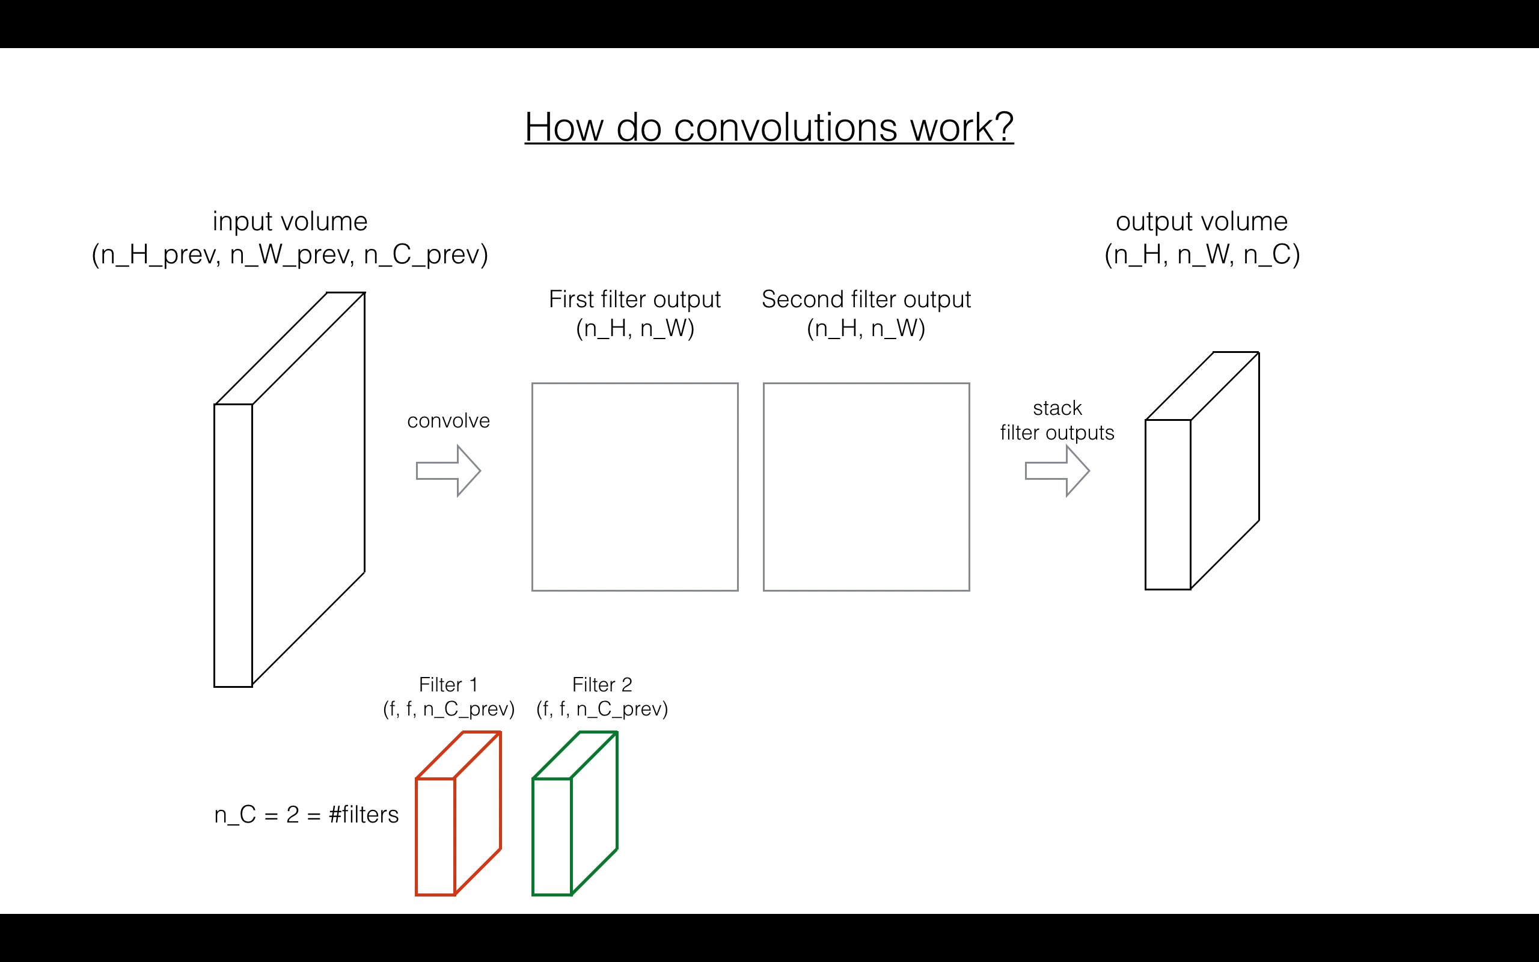
convolutions

Slide 20
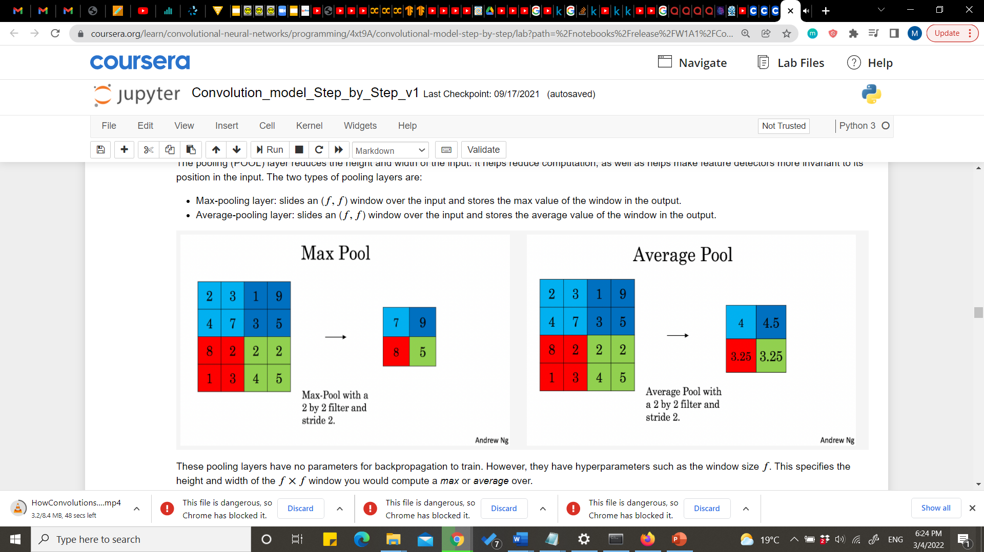
pooling
Average pooling
Max pooling

Slide 21
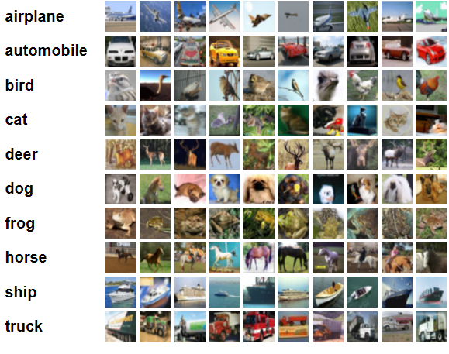
Cifar10

